Slide 1
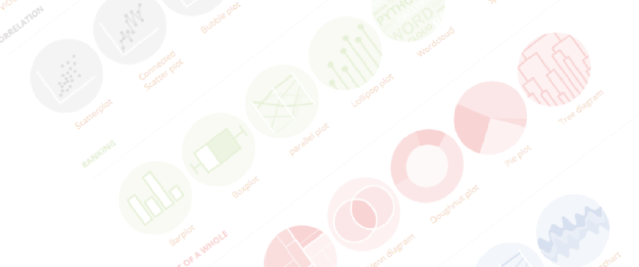
Introduction to data visualization
What, how, why, and more
Yan-holtz.com/teaching

Slide 2
What

Slide 3
Wikipedia definition
John snow map
Taking data, finding the good way to show it
Using picture to represent data
Notes:
Dinéusorus

Slide 4
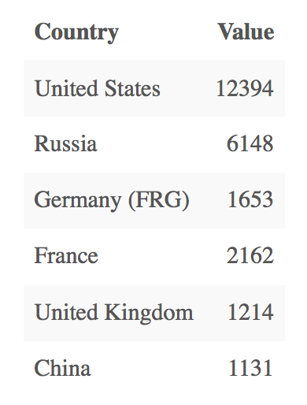
Who sells more weapons ?

Slide 5
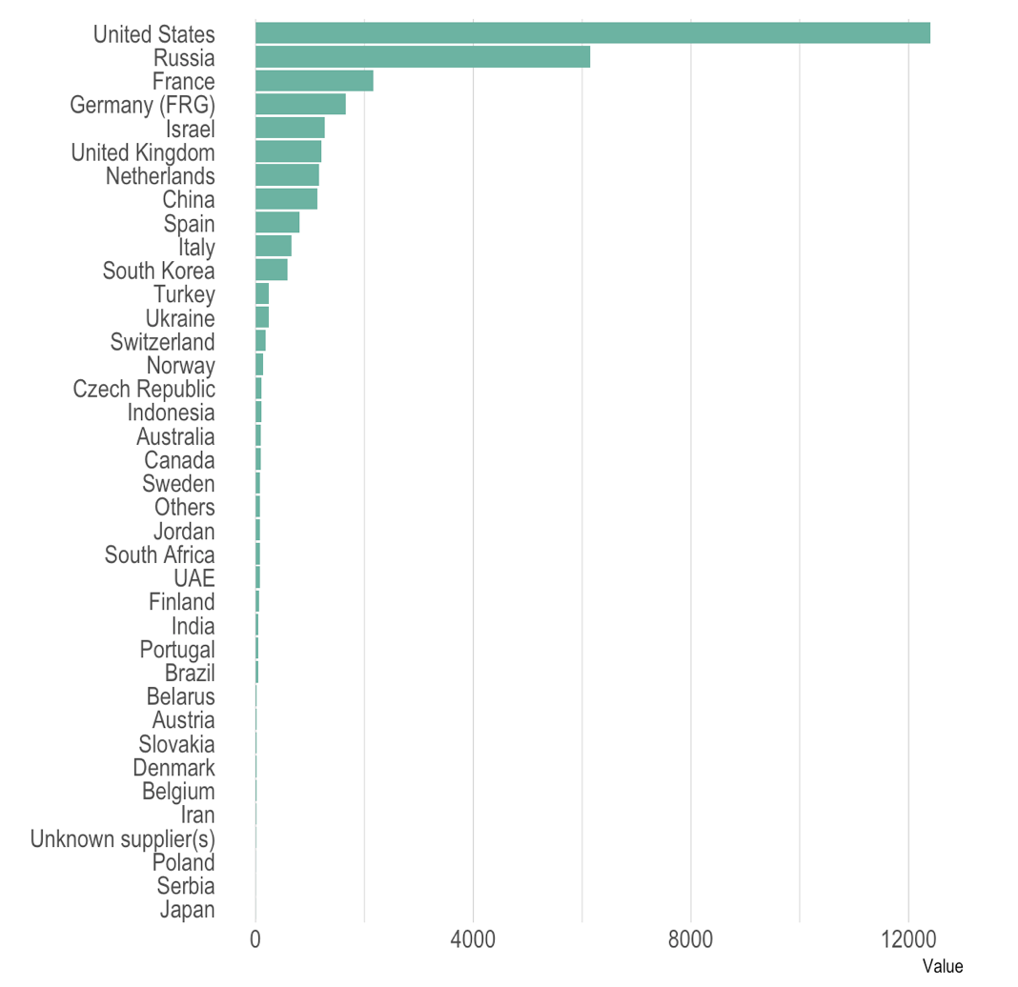
Who sells more weapons ?

Slide 6
A loooot of chart types
Which one do you know?
Show all Logos
Notes:
Dinéusorus

Slide 7
Type of output
Chart < Infographic < Interactivity < Dashboard < Story Telling
The pudding
Le monde
New york times
Notes:
Dinéusorus

Slide 8
Why
« A picture is worth a thousand words »

Slide 9
2/ Do you like Excel spreadsheet?
Can you understand them?
No, so you need to visualize it
Called the “picture superiority effect”
Find the slide of the dude with the table
Notes:
Dinéusorus

Slide 10
Y = 3 + 0.5x
Cor = 0.8
Mean(x) = 9
Var(x) = 11
Mean(Y) = 7.5
Var(Y) = 4.1
OK, but we have summary statistics!
Anscombe's quartet
Anscombe et al. 1973
Notes:
Dinéusorus

Slide 11

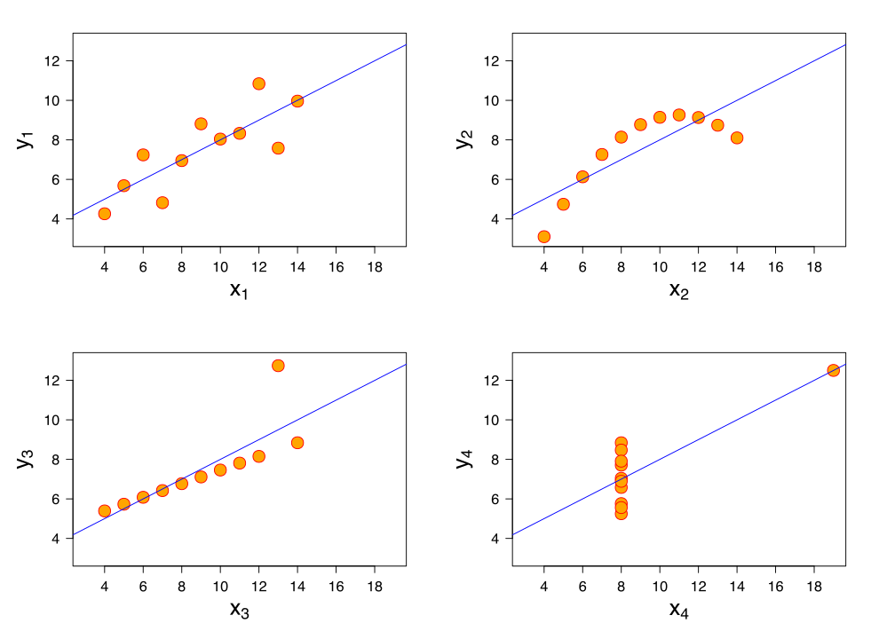
Y = 3 + 0.5x
Cor = 0.8
Mean(x) = 9
Var(x) = 11
Mean(Y) = 7.5
Var(Y) = 4.1
Notes:
Dinéusorus

Slide 12
Y = 3 + 0.5x
Cor = 0.8
Mean(x) = 9
Var(x) = 11
Mean(Y) = 7.5
Var(Y) = 4.1
Anscombe's quartet
Anscombe et al. 1973
Notes:
Dinéusorus

Slide 13
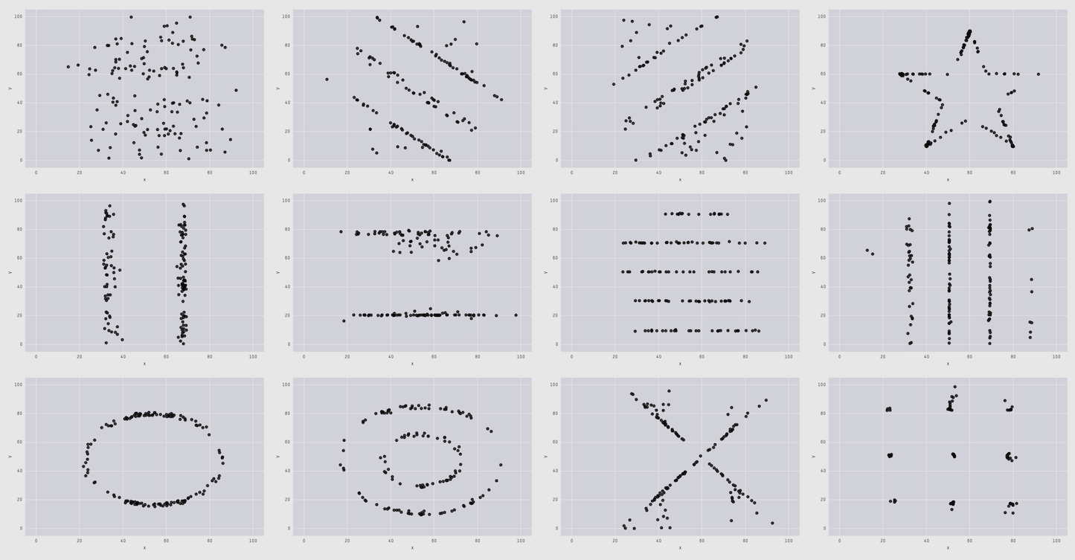
The Datasaurus Dozen
Cairo , 2017
Matejka & Fitzmaurice, 2017

Slide 14
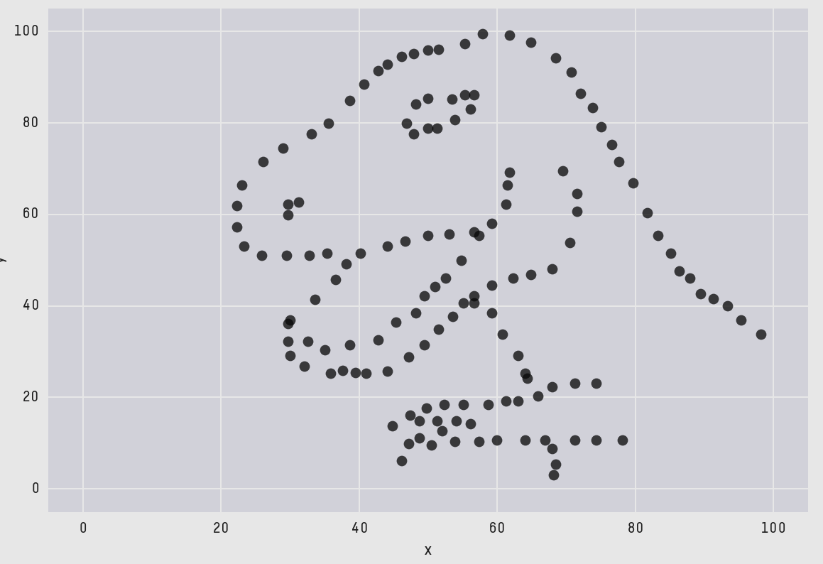
The Datasaurus Dozen
Cairo , 2017
Matejka & Fitzmaurice, 2017

Slide 15
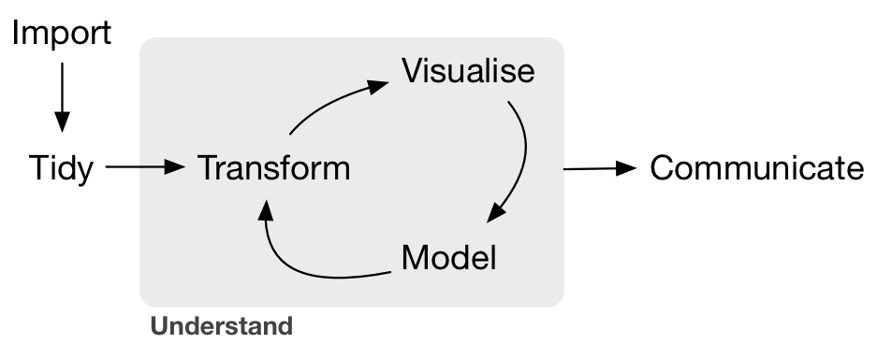
The Data Science Pipeline
R for Data Science, Whickam et al.
Notes:
Dinéusorus

Slide 16
2 main types of dataviz:
Exploratory
Explanatory
R for Data Science, Whickam et al.
Notes:
Dinéusorus

Slide 17
Can be beautifull
Notes:
Dinéusorus

Slide 18
Building the right Viz

Slide 19
Looking for a chart ?
What you can do
What you should do
Caveats to avoid
How to
build it

Slide 20
Who sells more weapons ?
?
Notes:
Very simple dataset,
-> What would you do ?
quantity of weapons exported by the top 50 largest exporters in 2017.
on the Stockholm International Peace Research Institute

Slide 21
Who sells more weapons ?

Slide 22
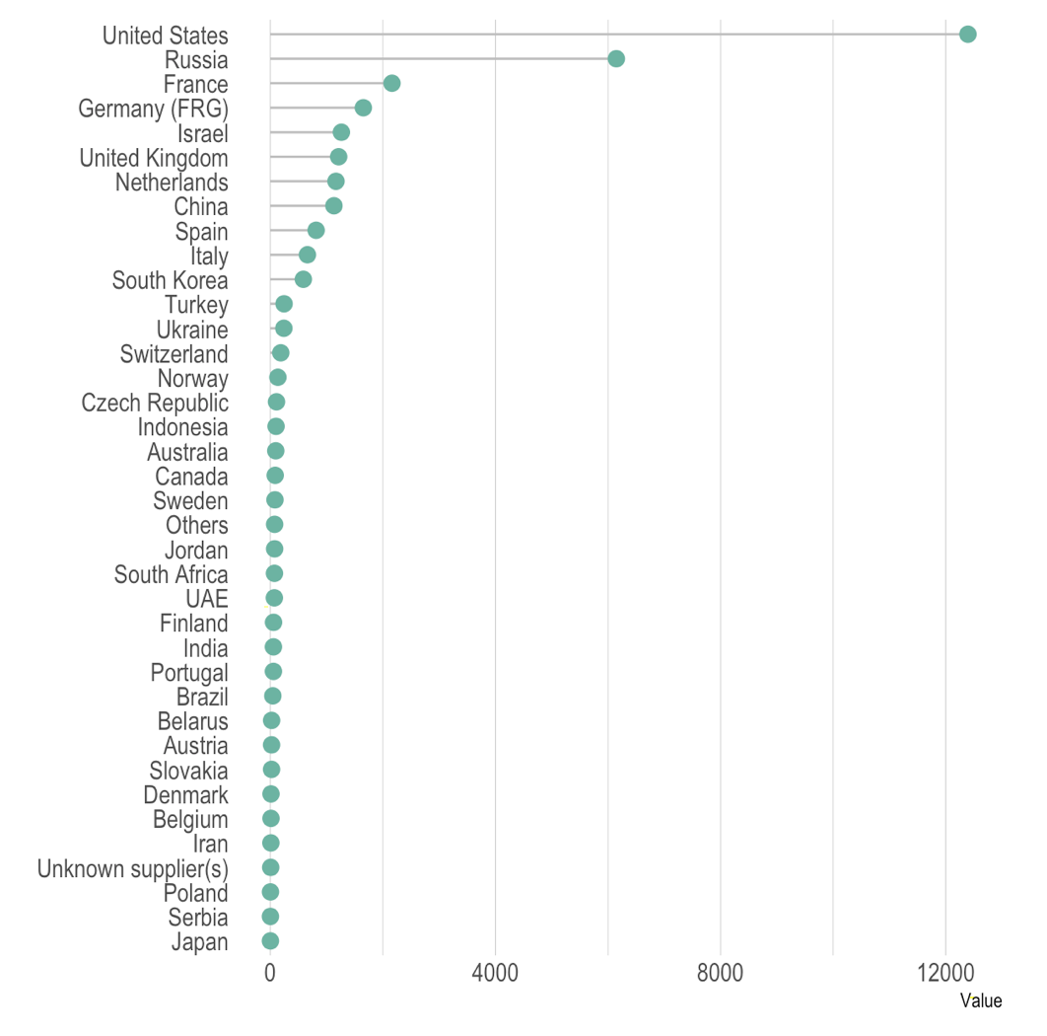
Who sells more weapons ?

Slide 23
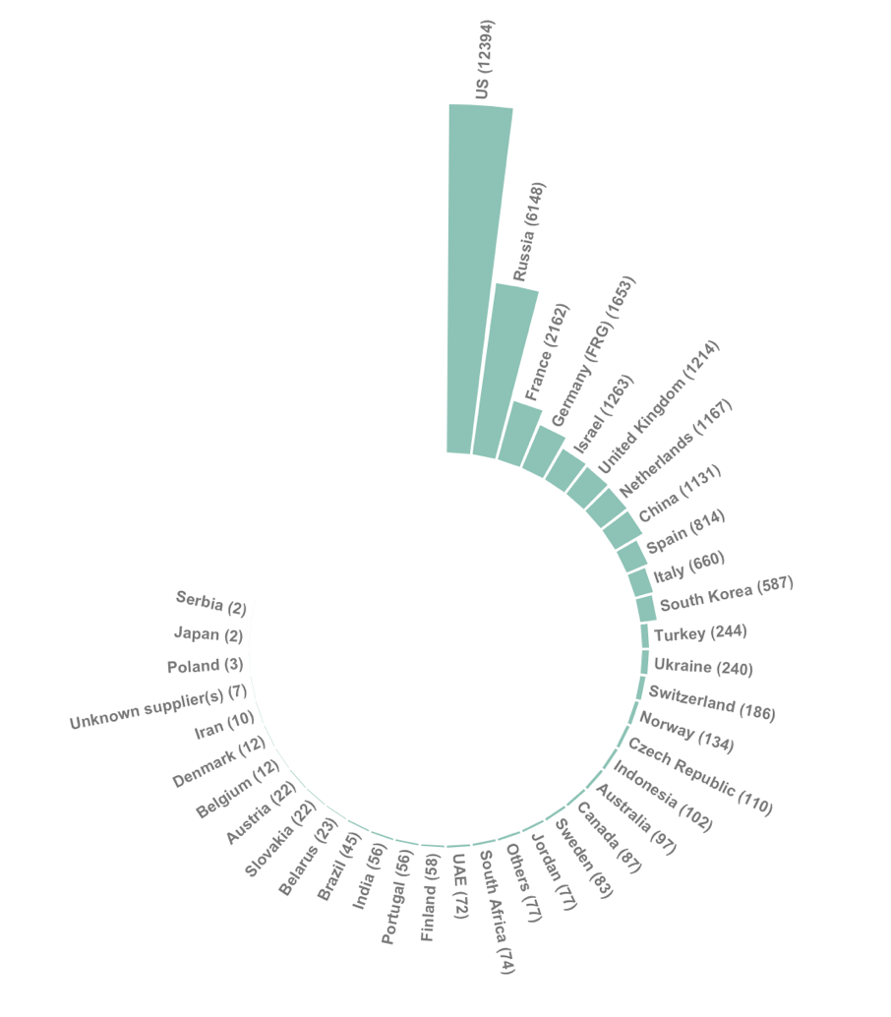
Who sells more weapons ?

Slide 24
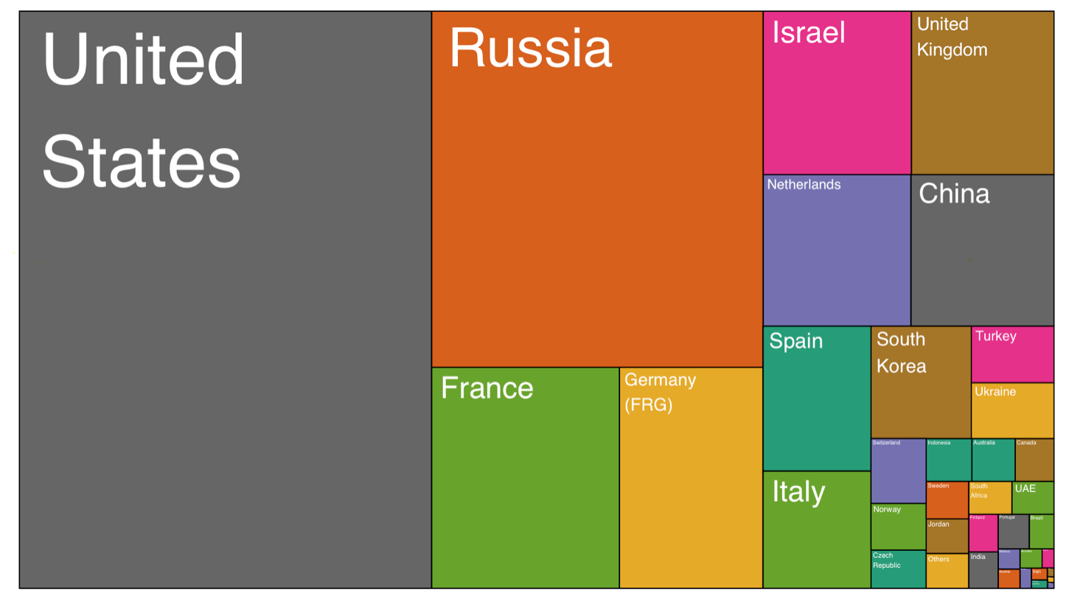
Who sells more weapons ?

Slide 25
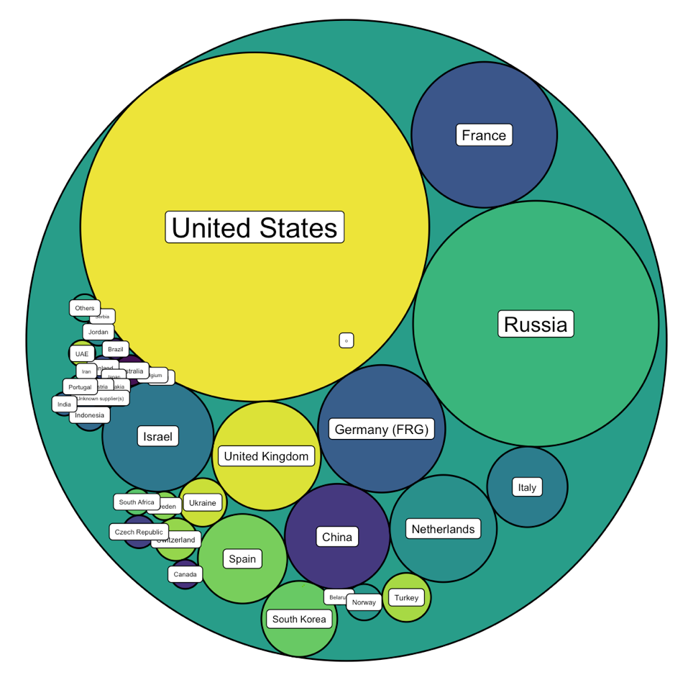
Who sells more weapons ?

Slide 26







Who sells more weapons ?

Slide 27
Eye catching / accurate
Question
Exploratory vs Explanatory
Chart Decision
Interactive or Static?
Who’s reading ?
Data itself

Slide 28
Examples

Slide 29


Slide 30
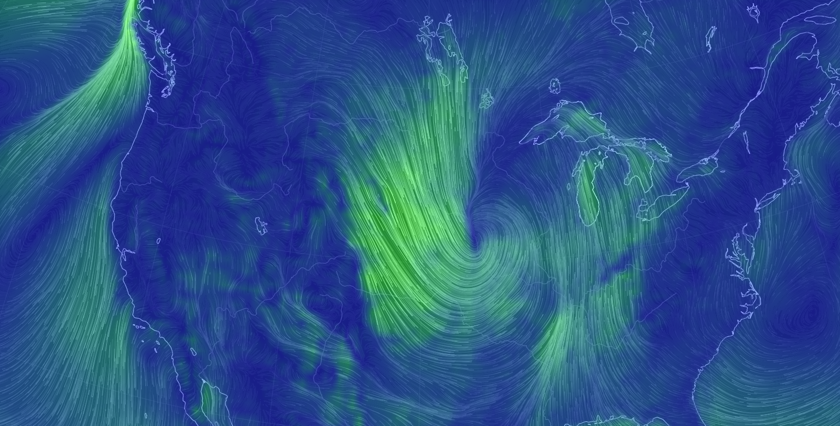
Notes:
Dinéusorus

Slide 31
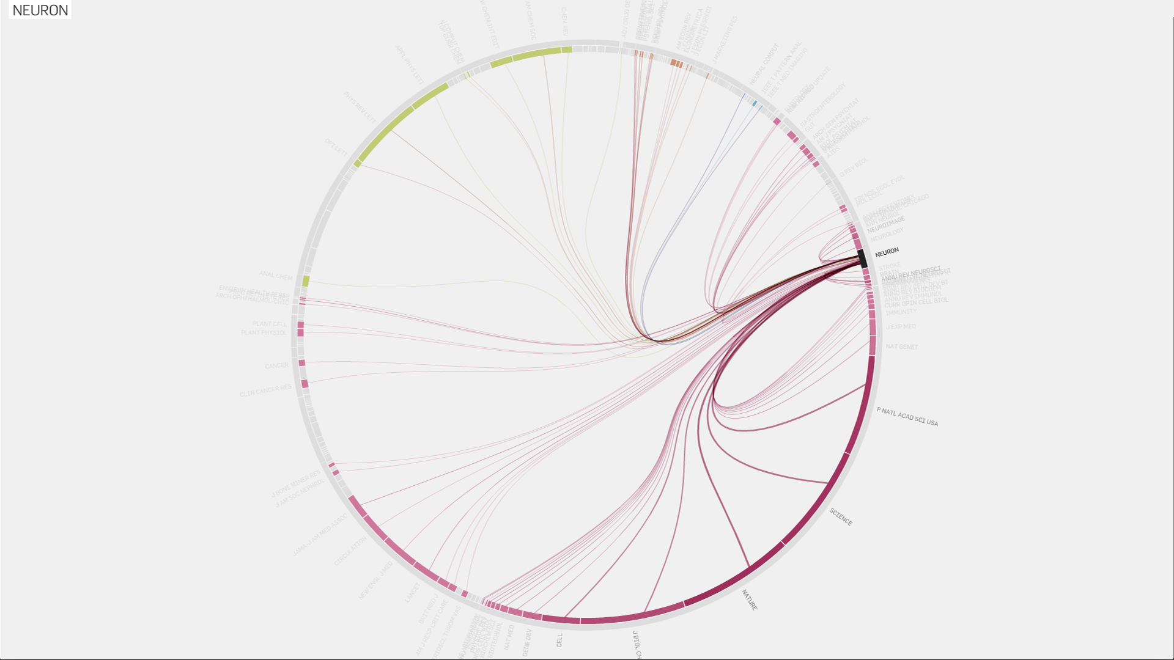
Truth-and-beauty.net
Notes:
Dinéusorus

Slide 32
How

Slide 33
See the chart maker directory by visualisingdata.com
Data Wrapper
R
Flourish
Python
Tableau
SAS
Jump
MatLab
Excel
QlikView
Julia
D3
Easy
Limited
Hard
Flexible
* Far from being exhaustive

Slide 34

See the chart maker directory by visualisingdata.com
Data Wrapper
R
Flourish
Python
Tableau
SAS
Jump
MatLab
Excel
QlikView
Julia
D3
Easy
Limited
Hard
Flexible
* Far from being exhaustive

Slide 35
Example:
Take a dataset
Explore it -> show explo graph
Make a visual one result is known
-> This is what you’re gonna do during the rest of the course
Notes:
Dinéusorus

Slide 36

R-graph-gallery.com
Python-graph-gallery.com
D3-graph-gallery.com
Notes:
Demo d3-graph gallery.com

Slide 37




Thanks
Yan.holtz.data@gmail.com
www.yan-holtz.com
Slides:
yan-holtz.com/teaching
@R_Graph_Gallery
github.com/holtzy

